Slide 1
Start using data.table
Megan Stodel
www.meganstodel.com
@MeganStodel
Notes:
The reality of data science is data wrangling
Two approaches to ‘start’
Mostly about advocating / encouraging use

Slide 2
About me
1

Slide 3
About me
Data scientist at the Ministry of Justice
Use R in most of my projects
No STEM qualifications
English BA
Gender and International Relations MSc

Slide 4
About data.table
2

Slide 5
DEFINING DATA.TABLE
A package in R
Originally released in 2006
730k downloads a month
A data structure
A way of manipulating data
Notes:
- More than generic interpretation

Slide 6
Why you should use data.table
3

Slide 7
speed matters
One of the most common criticisms of R is that it is slow
Speed can be particularly important in some instances:
Very complex models
Very big datasets
Apps or tools designed for general use
Code that you run often

Slide 8
Data.table is fast
One of the most common criticisms of R is that it is slow
Not data.table!
Things can be modified / altered by reference, so there is in-situ replacement without duplicating the table
You can perform numerous operations in one line, so don’t have to allocate memory for the intermediate result
Speed extends to reading in data using fread()

Slide 9
Benchmarks
-- Aggregation benchmarks here –
Data.table is consistently substantially faster, not only than dplyr, but also pandas and data structures in other languages.
Relative performance increases as data size increases.

Slide 10
Few dependencies
Data.table
dplyr
methods (base)
assertthat
glue
magrittr
pkgconfig
R6
Rcpp
rlang
tibble
tidyselect
utils (base)

Slide 11
No, really, Why you should use data.table
4

Slide 12
“dplyr is easier to learn and read than data.table”
It’s a matter of opinion! There is a really clear logic to data.table.
Once you’ve learnt it you’ll be fine.

Slide 13
“dplyr is more popular in general”
Show that you’re an independent thinker.
Both dplyr and data.table have similar usage within other packages, between them powering about 10-12% of CRAN (source).

Slide 14
“Nobody else in my team uses data.table”
Great opportunity for them to learn.
All data.tables are a type of data.frame, so you can use any functions that you use on data.frames without breaking the code.

Slide 15
Using data.table
5

Slide 16
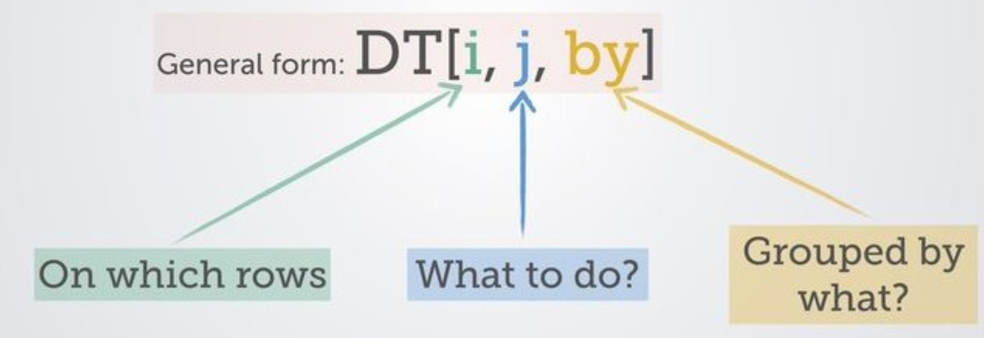
The syntax
(source)

Slide 17
Example:
DT[year == 2018, profit := sales – spend]
Filter the data.table to rows where the year value is 2018
Create a new column called “profit” that calculates the result of the number in the “sales” column minus the number in the “spend” column
(nothing in the “by” column)
Notes:
Also: columns are referred to as if they are variables, don’t need to use quotation marks or $
Also: note the way to assign without mutating using :=

Slide 18
Example:
DT[, .N, by = location]
Not filtering by anything (but need the comma)
A way to count the number of rows (like nrow())
Do this action for each distinct “location”

Slide 19
Useful resources
data.table site
data.table FAQ
A data.table and dplyr tour (includes comparison of operations in both packages)
Advanced tips and tricks with data.table (this is so good!)

Slide 20
QUestions
Megan Stodel
www.meganstodel.com
@MeganStodel

